Slide 1
Al-Farabi Kazakh National University
Higher School of Medicine
The human genome. Part I
Lecturer: PhD Pinsky Ilya Vladimirovich

Slide 2
LEARNING OUTCOMES
As a result of the lesson you will be able to:
1. Describe the structure of the human genome: protein-coding genes, intergenic regions (spacers), satellites, tandem repeats, single nucleotide polymorphisms (SNPs).
2. Explain the role of non-coding DNA in the human genome.
3. Discuss the prospects for applying knowledge about the human genome in medicine and pharmaceuticals.
4. Describe DNA transposons, retrotransposons, retroviral integration.
5. Provide examples of human diseases triggered by transposable elements.
6. Discuss the usage of transposable elements in medicine.

Slide 3
Literature:
1. Brown TA (2002). The Human Genome (2nd ed.). Oxford: Wiley-Liss.
2. Francis S. Collins. Medical and Societal Consequences of the Human Genome Project // N Engl J Med 1999; 341:28-37. DOI: 10.1056/NEJM199907013410106
3. Alberts et al., pp. 287-292.

Slide 4
Definition
The human genome is a complete set of nucleic acid sequences for humans, encoded as DNA within the 23 chromosome pairs in cell nuclei and in a small DNA molecule found within individual mitochondria. These are usually treated separately as the nuclear genome and the mitochondrial genome. Human genome includes both protein-coding DNA genes and noncoding DNA.
Human genome contains more than 3 billion base pairs and 25-30 thousand protein coding genes.

Slide 5
https://www.google.com/url?sa=i&url=https%3A%2F%2Fen.wikipedia.org%2Fwiki%2FHuman_Genome_Project&psig=AOvVaw2LbSxcKgoI1_-RcmBCyBVI&ust=1638796078165000&source=images&cd=vfe&ved=0CAwQjhxqFwoTCNDO3qbdzPQCFQAAAAAdAAAAABAU

Slide 6
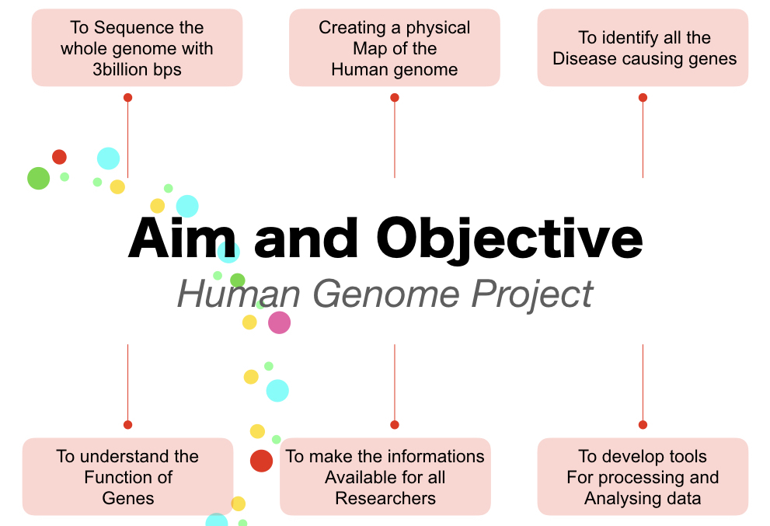
https://www.google.com/url?sa=i&url=https%3A%2F%2Fgeneticeducation.co.in%2Fthe-human-genome-project-aims-objectives-techniques-and-outcomes%2F&psig=AOvVaw2LbSxcKgoI1_-RcmBCyBVI&ust=1638796078165000&source=images&cd=vfe&ved=0CAwQjhxqFwoTCNDO3qbdzPQCFQAAAAAdAAAAABAY

Slide 7
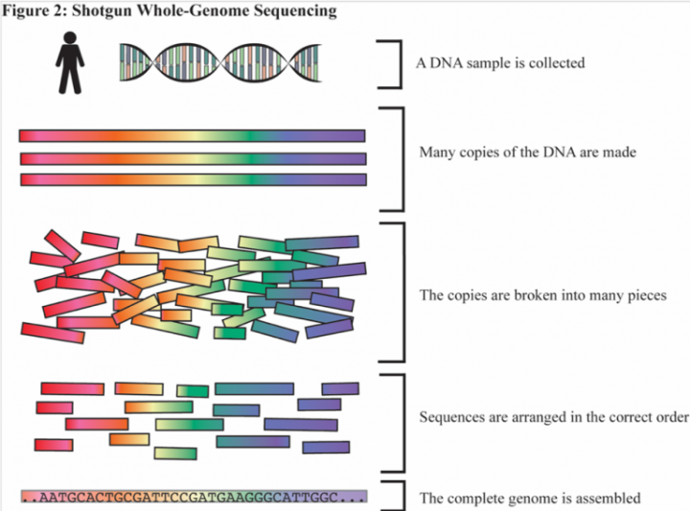
https://www.google.com/url?sa=i&url=https%3A%2F%2Fsitn.hms.harvard.edu%2Fflash%2F2019%2Flessons-from-the-human-genome-project%2F&psig=AOvVaw2LbSxcKgoI1_-RcmBCyBVI&ust=1638796078165000&source=images&cd=vfe&ved=2ahUKEwjAlYei3cz0AhWRzSoKHZ6vBHkQr4kDegUIARDMAQ

Slide 8
https://www.google.com/url?sa=i&url=https%3A%2F%2Fwww.researchgate.net%2Ffigure%2FExpected-impact-of-the-human-genome-project-on-medicine-as-envisioned-in-2003_fig2_260109480&psig=AOvVaw0T0HkqSAX-gzjplNLjYK4o&ust=1638795190259000&source=images&cd=vfe&ved=0CAwQjhxqFwoTCNi7sf_ZzPQCFQAAAAAdAAAAABAM

Slide 9
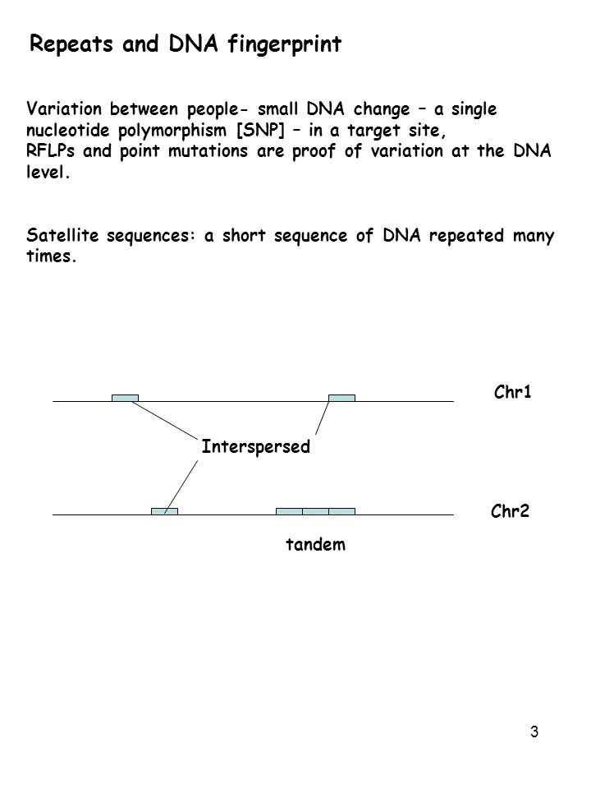
https://www.google.com/url?sa=i&url=https%3A%2F%2Fslideplayer.com%2Fslide%2F7622862%2F&psig=AOvVaw2HCKMFCTF6_gMLZ6D_3qjK&ust=1638792007965000&source=images&cd=vfe&ved=0CAwQjhxqFwoTCKDMpJXOzPQCFQAAAAAdAAAAABAp

Slide 10
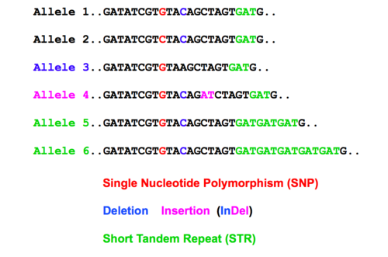
https://www.google.com/url?sa=i&url=https%3A%2F%2Fquizlet.com%2Fau%2F520356548%2Fbms2042-week-4-flash-cards%2F&psig=AOvVaw2HCKMFCTF6_gMLZ6D_3qjK&ust=1638792007965000&source=images&cd=vfe&ved=0CAwQjhxqFwoTCKDMpJXOzPQCFQAAAAAdAAAAABAJ

Slide 11
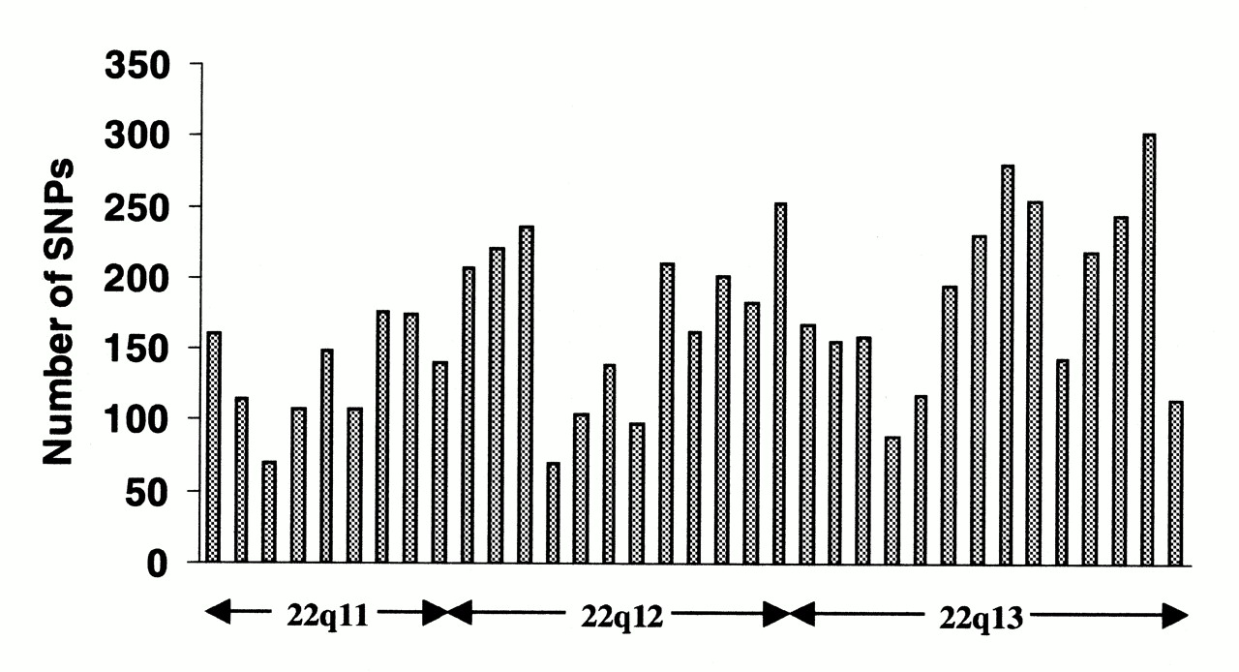
SNP distribution along the long arm of chromosome 22 (from https://web.archive.org/web/20130903043223/http://snp.cshl.org/ ). Each column represents a 1 Mb interval; the approximate cytogenetic position is given on the x-axis. Clear peaks and troughs of SNP density can be seen, possibly reflecting different rates of mutation, recombination and selection.
By Gray IC1, Campbell DA, Spurr NK. - https://www.ncbi.nlm.nih.gov/pubmed/11005795, CC0, https://commons.wikimedia.org/w/index.php?curid=45616650

Slide 12
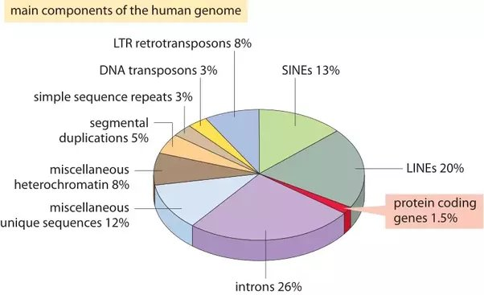
https://www.google.com/url?sa=i&url=https%3A%2F%2Fwww.quora.com%2FIs-non-coding-DNA-important-to-an-organism-in-any-way-Why-is-it-studied&psig=AOvVaw1RYAwMokIj3VJG99IRaVr6&ust=1638797212197000&source=images&cd=vfe&ved=0CA0QjhxqFwoTCLjc3sPhzPQCFQAAAAAdAAAAABBg

Slide 13
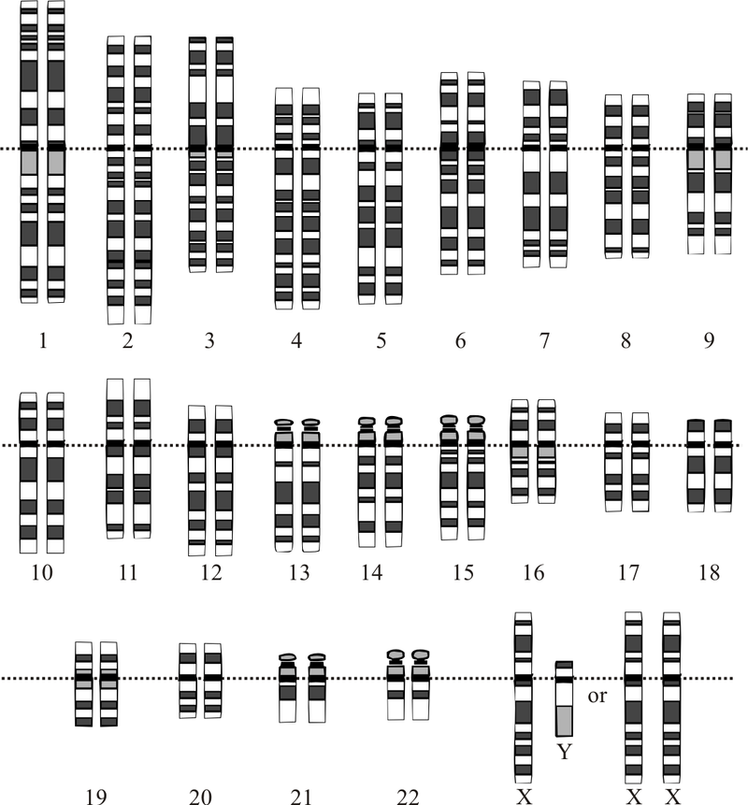
Courtesy: National Human Genome Research Institute - Modified from Human Genome Project From en: with same file name, contributor: en:User:TedE

Slide 14
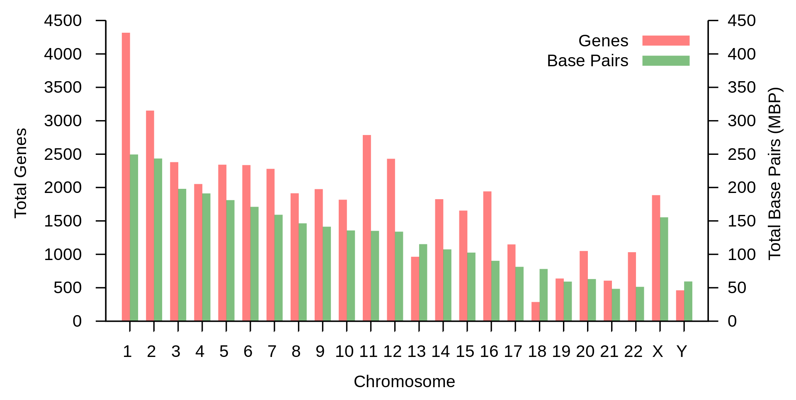
By Friend of a friends - Own work, CC BY-SA 3.0, https://commons.wikimedia.org/w/index.php?curid=18594472

Slide 15
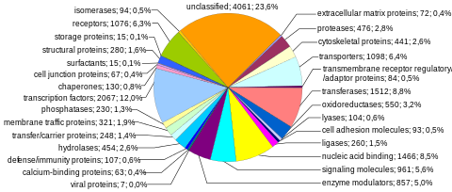
https://www.google.com/url?sa=i&url=https%3A%2F%2Fen.wikipedia.org%2Fwiki%2FHuman_genome&psig=AOvVaw2Aw7Ox0xLbc8llqIMRNvCF&ust=1638789843585000&source=images&cd=vfe&ved=0CAwQjhxqFwoTCLDYnY3GzPQCFQAAAAAdAAAAABAD

Slide 16
Ensembl genome browser (July 2012)

Slide 17
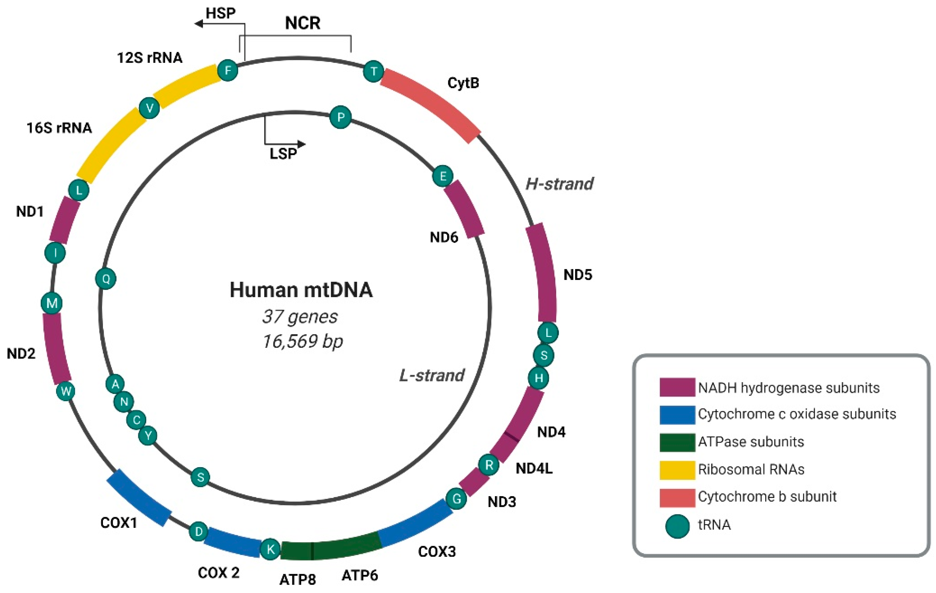
https://www.google.com/url?sa=i&url=https%3A%2F%2Fwww.mdpi.com%2F1422-0067%2F22%2F15%2F7999%2Fhtm&psig=AOvVaw0mR7FO5Af_JvxmsEFC_w_P&ust=1638813635949000&source=images&cd=vfe&ved=0CAwQjhxqFwoTCPC8p9mezfQCFQAAAAAdAAAAABBB

Slide 19
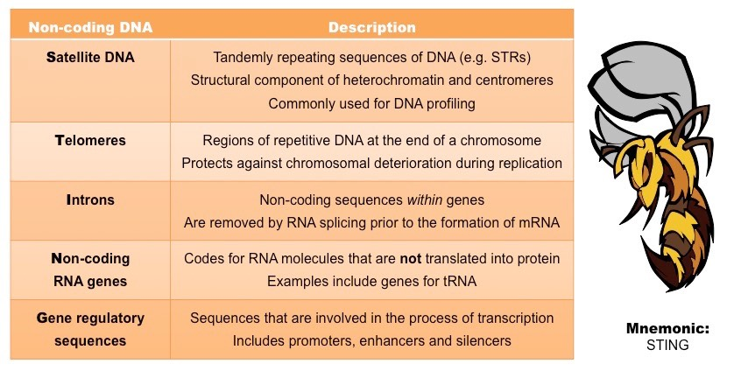
https://www.google.com/url?sa=i&url=http%3A%2F%2Fib.bioninja.com.au%2Fhigher-level%2Ftopic-7-nucleic-acids%2F71-dna-structure-and-replic%2Fnon-coding-dna.html&psig=AOvVaw1RYAwMokIj3VJG99IRaVr6&ust=1638797212197000&source=images&cd=vfe&ved=0CAwQjhxqGAoTCLjc3sPhzPQCFQAAAAAdAAAAABCJAQ

Slide 21
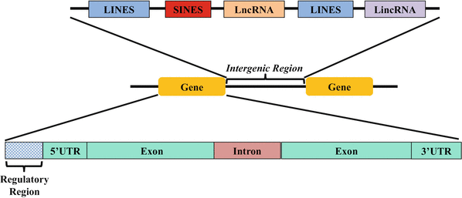
https://www.google.com/url?sa=i&url=https%3A%2F%2Flink.springer.com%2F10.1007%2F978-3-319-47829-6_64-1&psig=AOvVaw0rV1x_RmKwMdRQW_jjjlV9&ust=1638791813671000&source=images&cd=vfe&ved=0CAwQjhxqFwoTCLiDp7rNzPQCFQAAAAAdAAAAABAS

Slide 23
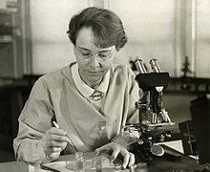
Mobile genetic elements were discovered by Barbara McClintock during the 1940s and 1950s. She was awarded the 1983 Nobel Prize in Physiology and Medicine for this discovery.

Slide 27
Diseases causing by transposable elements
The consequences of mobile genetic elements can alter the transcriptional patterns, which frequently leads to genetic disorders such as immune disorders, breast cancer, multiple sclerosis, and amyotrophic lateral sclerosis. In humans, stress can lead to transactional activation of MGEs such as endogenous retrovirus, and this activation has been linked to neurodegeneration.
Antony, Joseph M; Marle, Guido van; Opii, Wycliffe; Butterfield, D Allan; Mallet, François; Yong, Voon Wee; Wallace, John L; Deacon, Robert M; Warren, Kenneth (October 2004). "Human endogenous retrovirus glycoprotein–mediated induction of redox reactants causes oligodendrocyte death and demyelination". Nature Neuroscience. 7 (10): 1088–1095. doi:10.1038/nn1319. PMID 15452578.

